Slide 1
Database Design

Slide 2
Design
Business tables
Support tables: statistics, config…
Every table has a primary key
Max length and nullability strictly follow field definitions
Follow 3NF normalization

Slide 3
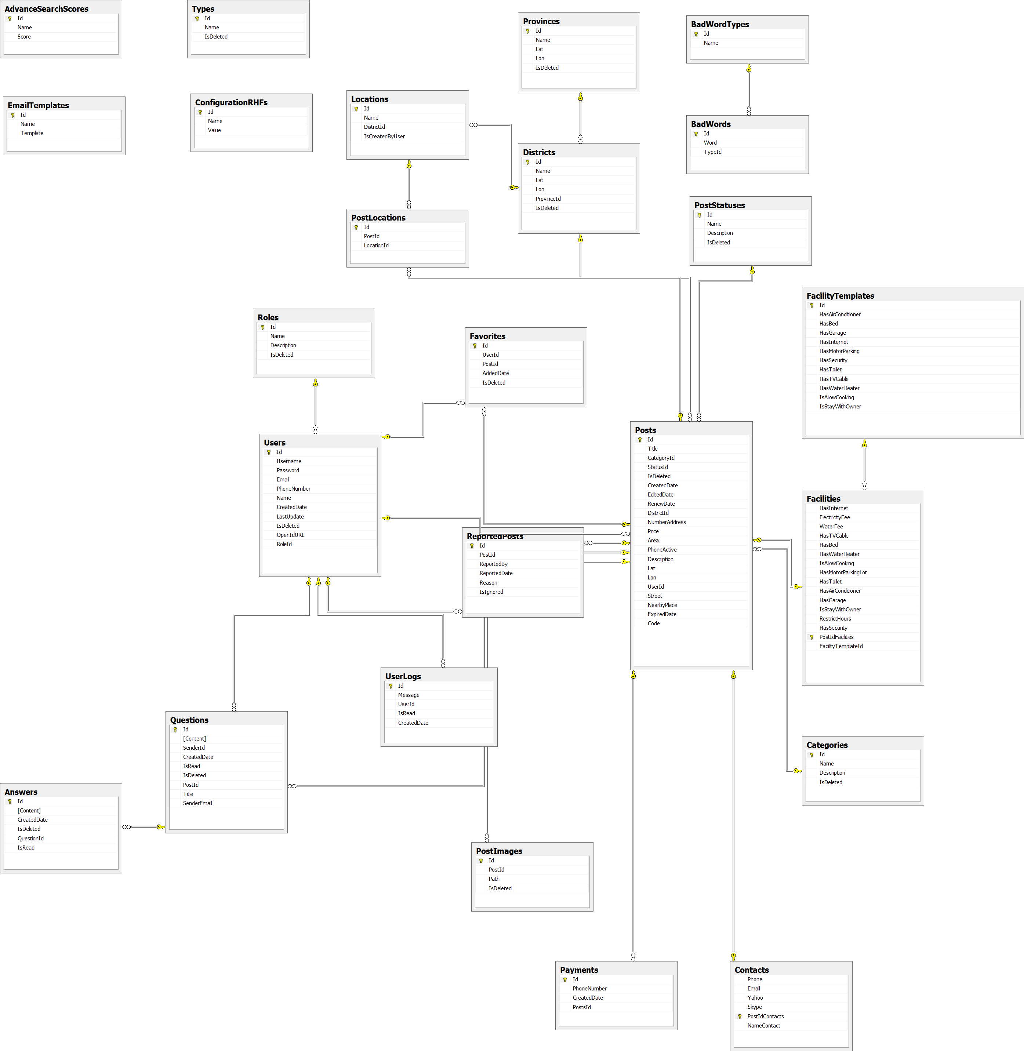
Tables

